Slide 1

Dealing with Estimation, Uncertainty, Risk, and Commitment :
An Outside-In Look at Agility and Risk Management
Todd Little
Sr. Development Manager
Landmark Software & Services
Notes:
Todd comes from Oil and Gas exploration, a business that deals with risk in many facets. Chris comes from investment banking, another area that has made it important to understand and comprehend issues associated with risk. Both Todd and Chris have spent their careers developing software in these industries.

Slide 2

Agenda
Introduction
Exercise
Estimation and Uncertainty
Risk
Break
Risk Management Tools
Exercise
Summary

Slide 3
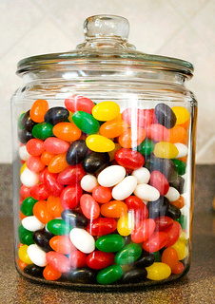
Estimation Exercise
Number of Jellybeans in the jar
Ratio of the highest estimate (P90) to the lowest estimate (P10)

Slide 4
#1: Estimation challenges are well understood by General Management, Project Management, and Teams

Slide 5
#2: Estimators and teams understand the limitations of their estimates

Slide 6
#3: It is normal to be able to estimate projects within 25% accuracy

Slide 7
#4: Estimation accuracy significantly improves as the project progresses

Slide 8
#5: Estimations are frequently impacted by biases and these biases can be significant.

Slide 9
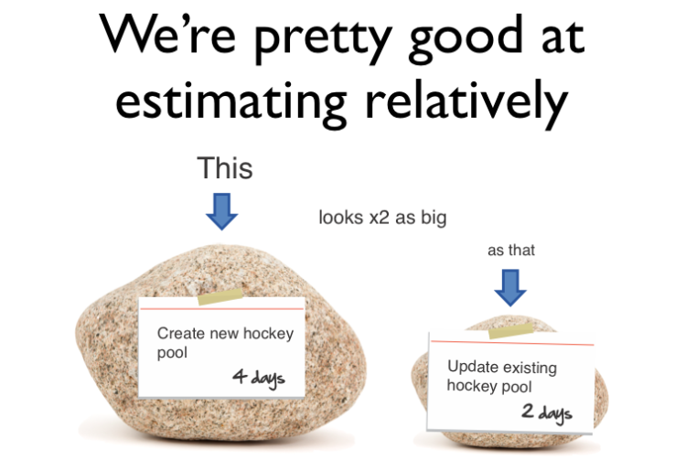
#6: We’re pretty good as estimating things relatively

Slide 10
#7: Velocity is a good tool for adjusting estimates.

Slide 11
#8: We’re a bit behind, but we’ll make it up in testing since most of our uncertainty was in the features.

Slide 12
#9: Scope Creep is a major source of estimation error.

Slide 13
#10: Having more estimators, even if they are not experts, improves estimation accuracy

Slide 14
#11: Estimation tools are more accurate than expert or judgment estimation

Slide 15
#12: Project success is determined by on-time delivery

Slide 16
#13: Estimation is waste

Slide 17
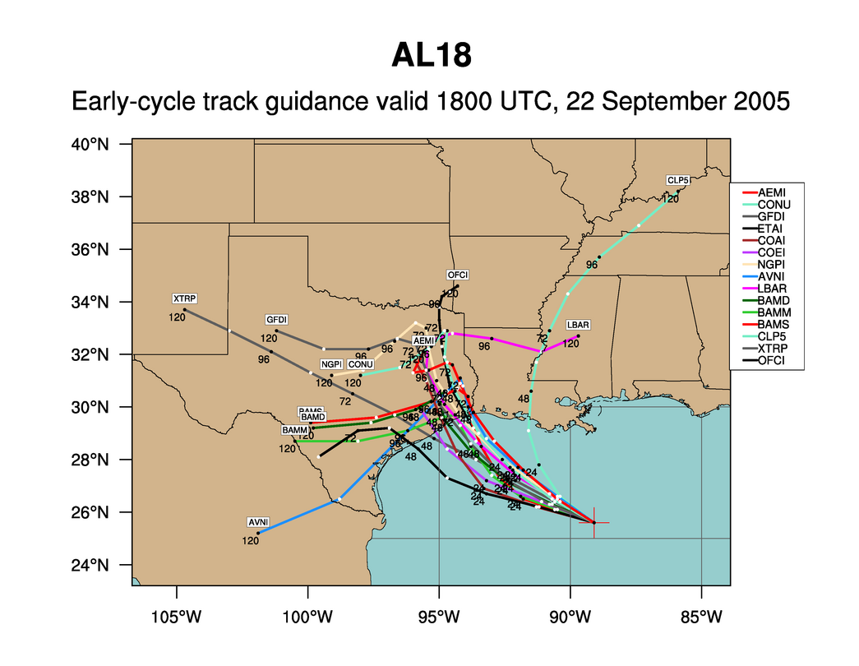
Hurricane Rita
Notes:
What can we say about every one of these predictions? They are wrong. But the collective set of predictions is quite useful. Which is more important when predicting hurricanes – where it hits or when it hits? Ok, both are important, but where is much more important than when. If you are in Florida you don’t really care when it hits. But once you know it has a chance to hit Houston then it is very important to know when it might hit.

Slide 18
Delivery Challenges/Failures
Standish Group 2006, reported by CEO Jim Johnson, CIO.com, ‘How to Spot a Failing Project’
Notes:
Delivery failures are well documented in the software business.
This is the classic report from Standish showing only 35% of projects delivered on time with expected features. 46% were challenged and 19% were killed. This is from 2006, and is a substantial improvement from the 19% success rate in 1996.

Slide 19




Managing the Coming Storm
Inside the Tornado
Project Kickoff
When will we get the requirements?
All in good time, my little pretty, all in good time
But I guess it doesn't matter anyway
Just give me your estimates by this afternoon
Team Unity
Not so fast! Not so fast! ... I'll have to give the matter a little thought. Go away and come back tomorrow
No, we need something today!
Ok then, it will take 2 years.
No, we need it sooner.
Doesn't anybody believe me?
I already promised the customer it will be out in 6 months
You're a very bad man!
Notes:
We look at a typical software project…..

Slide 20


We’re not in Kansas Anymore
Developer Hero
I may not come out alive, but I'm goin' in there!
Reorg
The Great and Powerful Oz has got matters well in hand.
My! People come and go so quickly here!
Testing
"Hee hee hee ha ha! Going so soon? I wouldn't hear of it! Why, my little party's just beginning!

Slide 21
Why is Software Late?
Genuchten 1991 IEEE
General Manager | Project Manager | Item
1 | 10 | Insufficient front end planning
2 | 3 | Unrealistic project plan
3 | 8 | Project scope underestimated
4 | 1 | Customer/management changes
5 | 14 | Insufficient contingency planning
6 | 13 | Inability to track progress
7 | 5 | Inability to track problems early
8 | 9 | Insufficient Number of checkpoints
9 | 4 | Staffing problems
10 | 2 | Technical complexity
11 | 6 | Priority Shifts
12 | 11 | No commitment by personnel to plan
13 | 12 | Uncooperative support groups
14 | 7 | Sinking team spirit
15 | 15 | Unqualified project personnel

Slide 22
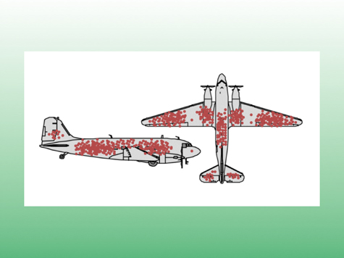
The Context of Feedback

Slide 23
Why is Software Late?
Genuchten 1991 IEEE
General Manager | Project Manager | Item
4 | 1 | Customer/management changes
10 | 2 | Technical complexity
2 | 3 | Unrealistic project plan
9 | 4 | Staffing problems
7 | 5 | Inability to track problems early
11 | 6 | Priority Shifts
14 | 7 | Sinking team spirit
3 | 8 | Project scope underestimated
8 | 9 | Insufficient Number of checkpoints
1 | 10 | Insufficient front end planning
12 | 11 | No commitment by personnel to plan
13 | 12 | Uncooperative support groups
6 | 13 | Inability to track progress
5 | 14 | Insufficient contingency planning
15 | 15 | Unqualified project personnel
Notes:
The project manager is much closer to the actual work being done and so I tend to think their response is closer to reality. What is of particular interest is where there is a discrepancy between the General Manager and the Project Manager.
1 4 Customer/management changes
PM: They were constantly changing their minds GM:OK, so we changed a few things once in a while
2 10 Technical complexity
PM: We were using new technology and had to discover all the limitations GM: I just to them to make it look like that cool demo I saw
3 2 Unrealistic project plan
PM: We told them it would take longer GM: I had to push them so that they would be serious
4 9 Staffing problems
PM: We couldn’t get the people we needed GM: I gave them everyone I had available
5 7 Inability to track problems early
PM/GM: agree --- We didn’t know what we didn’t know
6 11 Priority Shifts
PM: They were constantly changing their minds GM: We didn’t change that much
7 14 Sinking team spirit
PM: The team felt overworked and underappreciated GM: We’ve got a great team. What spirit they have
8 3 Project scope underestimated
PM: I didn’t really feel that we underestimated it. We told them it would be hard GM: We really didn’t think it was such a big project
9 8 Insufficient Number of checkpoints
PM/GM agree – it would have been good to have better visibility into what was going on
10 1 Insufficient front end planning
PM: We had a plan, but they didn’t like the answer and kept changing their mind GM: It all would have been fine if we could have just planned better
11 12 No commitment by personnel to plan
PM/GM agree – team was willing to commit
12 13 Uncooperative support groups
PM/GM agree – support groups were willing to help
13 6 Inability to track progress
PM: We had pretty good tracking GM: I wish I had better visibility into what was going on so I could have done something
14 5 Insufficient contingency planning
PM: We had decent contingency planning, we just weren’t able to do anything GM: We just needed better planning
15 15 Unqualified project personnel
PM/GM agree – people are our most important assets

Slide 24
Why is Software Late?
Genuchten 1991 IEEE
General Manager | Project Manager | Item
H | H | Customer/management changes
L | H | Overall complexity
H | H | Unrealistic project plan
M | H | Staffing problems
H | L | Insufficient front end planning
Notes:
The project manager is much closer to the actual work being done and so I tend to think their response is closer to reality. What is of particular interest is where there is a discrepancy between the General Manager and the Project Manager.
1 4 Customer/management changes
PM: They were constantly changing their minds GM:OK, so we changed a few things once in a while
2 10 Technical complexity
PM: We were using new technology and had to discover all the limitations GM: I just to them to make it look like that cool demo I saw
3 2 Unrealistic project plan
PM: We told them it would take longer GM: I had to push them so that they would be serious
4 9 Staffing problems
PM: We couldn’t get the people we needed GM: I gave them everyone I had available
5 7 Inability to track problems early
PM/GM: agree --- We didn’t know what we didn’t know
6 11 Priority Shifts
PM: They were constantly changing their minds GM: We didn’t change that much
7 14 Sinking team spirit
PM: The team felt overworked and underappreciated GM: We’ve got a great team. What spirit they have
8 3 Project scope underestimated
PM: I didn’t really feel that we underestimated it. We told them it would be hard GM: We really didn’t think it was such a big project
9 8 Insufficient Number of checkpoints
PM/GM agree – it would have been good to have better visibility into what was going on
10 1 Insufficient front end planning
PM: We had a plan, but they didn’t like the answer and kept changing their mind GM: It all would have been fine if we could have just planned better
11 12 No commitment by personnel to plan
PM/GM agree – team was willing to commit
12 13 Uncooperative support groups
PM/GM agree – support groups were willing to help
13 6 Inability to track progress
PM: We had pretty good tracking GM: I wish I had better visibility into what was going on so I could have done something
14 5 Insufficient contingency planning
PM: We had decent contingency planning, we just weren’t able to do anything GM: We just needed better planning
15 15 Unqualified project personnel
PM/GM agree – people are our most important assets

Slide 25
The Goal
On Time
To Spec
Within Budget
Notes:
But this is not the answer…..This is an episode of Fantasy Island

Slide 26
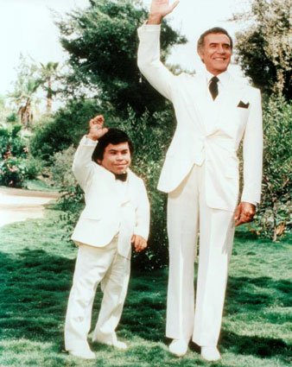
Da Plan, Boss – Da Plan

Slide 27
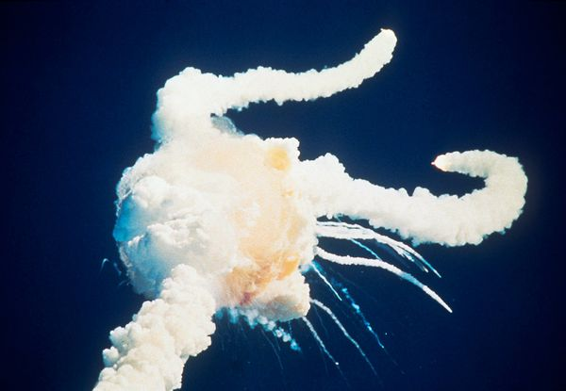
Space Shuttle Challenger
 | Engineers | Management
Probability of loss of life | 1 in 100 | 1 in 100,000

Slide 28

#1: Estimation challenges are well understood by General Management, Project Management, and Teams

Slide 29

Overconfidence in Ranges
Most people are significantly overconfident about their estimates, especially educated professionals
90% Confidence Interval

Slide 30
Overconfidence of Success
Matthew G. Miller, Ray J. Dawson, Kieran B. Miller, Malcolm Bradley (2008). New Insights into IT Project Failure & How to Avoid It. Presented at 22nd IPMA World Congress -­‐ Rome (Italy) November 9-­‐11, 2008, in Stream 6. As of May 2013, self published at http://www.mgmiller.co.uk/files/paper.pdf

Slide 31
#2: Estimators and teams understand the limitations of their estimates

Slide 32
IEEE Software, May/June 2006
Notes:
This is from an IEEE Software article that I published in May 2006

Slide 33
Accuracy of Initial Estimate

Slide 34
Probability Distribution Curve
Notes:
Here is the probability distribution for DeMarco’s data and the LGC data together. Our medians are nearly identical, but our standard deviation is lower, hence the tighter curve.
See the log normal curve shape, as this is plotted on a Cartesian axis. While there are the number of points on either side of the median, there is more area to the right of the median. Thus, the mean of the distribution is higher than the median.

Slide 35
Log Normal Distribution
Estimation Accuracy follows a Log Normal distribution
Median
Mean
Notes:
Log Normal distribution works against us, because the curve is skewed to the right. The average or mean is greater than the p(50).

Slide 36
Uncertainty Bounds
10% exceed 3-4x
Median project 1.7x
10-20% on time

Slide 37
Jørgensen 2013
Put website online marketplace to bid on vWorker.com
Received 16 bids.
Reduced down to 6 bids from vendors that had high (9.5) client satisfaction.
All 6 bidders went ahead and built the website

Slide 38
Jørgensen 2013
Actual/Est
  .7 – 2.9 (4x)
Est/Low Est
  8x
Act/LowAct
  18X

Slide 39
#3: It is normal to be able to estimate projects within 25% accuracy

Slide 40
How does Estimation Accuracy Improve Over Time?
Notes:
The conventional wisdom is that estimation gets better as the project progresses. This was first stated by Barry Boehm in COCOMO II, and stated by many authors subsequently, most notably Steve McConnell. At the Feasibility state the uncertainty band is 16X, while at Concept it has narrowed to 4X and by the Requirements it has reduced to 2.25X. This makes a lot of sense.

Slide 41
Landmark Cone of Uncertainty

Slide 42
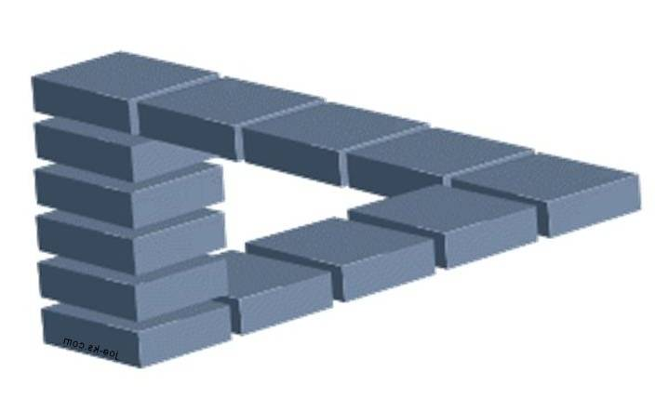
But is Uncertainty Really Reduced?
“Take away an ordinary person’s illusions and you take away happiness at the same time.”
Henrik Ibsen--Villanden

Slide 43
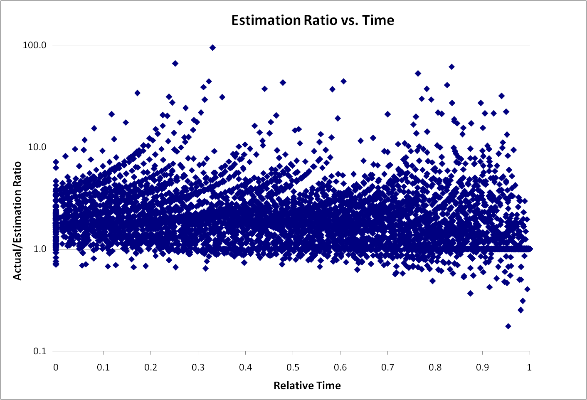
Remaining Uncertainty

Slide 44
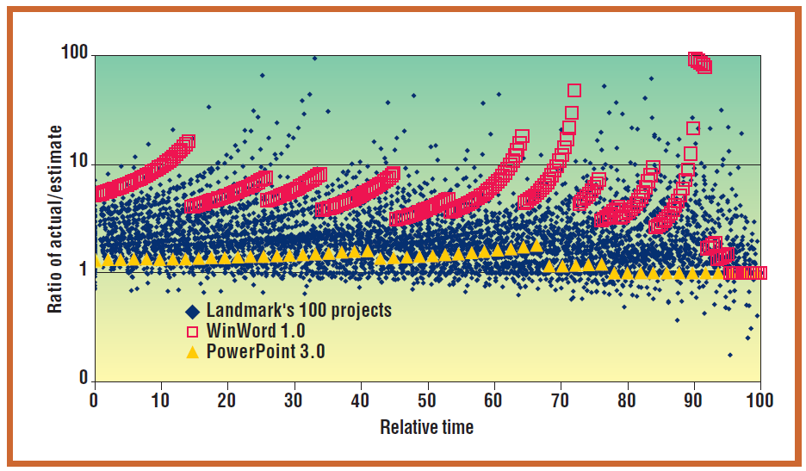
Remaining Uncertainty

Slide 45
#4: Estimation accuracy significantly improves as the project progresses

Slide 46
Sources of Error
Bias
Uncertainty Range
Scope Creep

Slide 47
Sources of Error
Bias
Median
Mean
Estimate

Slide 48
Negotiation Bias
"It is difficult to get a man to understand something when his salary depends upon his not understanding it.“
        Upton Sinclair:

Slide 49
Politics and Schedule Estimation
Developers tend to be temperamentally opposed to the use of negotiating tricks. Such tricks offend their sense of technical accuracy and fair play. Developers don't want to offer lopsidedly high initial estimates even when they know that customers, marketers, or bosses will start with lopsidedly low bargaining positions.
  Steve McConnell
http://www.stevemcconnell.com/ieeesoftware/bp03.htm

Slide 50
Test 1 (Jørgensen IEEE Software 2008)
Group | Guidance | Result
A | 800
B | 40
C | 4
D | None | 160

Slide 51
Test 1
Group | Guidance | Result
A | 800 | 300
B | 40 | 100
C | 4 | 60
D | None | 160

Slide 52
Test 2
Group | Guidance | Result
A | Minor Extension
B | New Functionality
C | Extension | 50

Slide 53
Test 2
Group | Guidance | Result
A | Minor Extension | 40
B | New Functionality | 80
C | Extension | 50

Slide 54
Test 3
Group | Guidance | Result
A | Future work at stake, efficiency will be measured
B | Control | 100

Slide 55
Test 3
Group | Guidance | Result
A | Future work at stake, efficiency will be measured | 40
B | Control | 100

Slide 56
Understand Bias
"What gets us into trouble is not what we don't know. It's what we know for sure that just ain't so.“
        Mark Twain

Slide 57

#5: Estimations are frequently impacted by biases and these biases can be significant.

Slide 58
Relative Sizing

Slide 59
Did you know? (Jørgensen IEEE Software March 2013)
The US has 155 million more inhabitants than Mexico, but Mexico only has 100 million fewer inhabitants than the US.
Poland has 10 million more inhabitants than Romania, but Romania has about the same number of inhabitants as Poland.
Austria’s population is 70% of Hungary’s, while Hungary’s population is 80% of Austria’s.

Slide 60
#6: We’re pretty good as estimating things relatively

Slide 61

Velocity Helps Remove Bias
$\frac{Story Points}{Velocity= \frac{Story Points}{Iteration}}=Iterations$

Slide 62
But Velocity is not a Silver Bullet
Story Estimate

Slide 63
#7: Velocity is a good tool for adjusting estimates.

Slide 64

Sources of Error
Range of Uncertainty

Slide 65
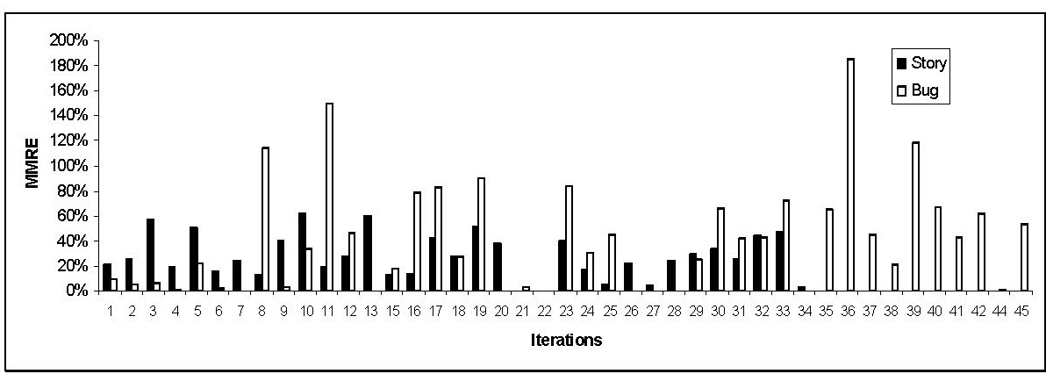
Estimation Errors
Lan Cao - Estimating Agile Software Project Effort: An Empirical Study

Slide 66
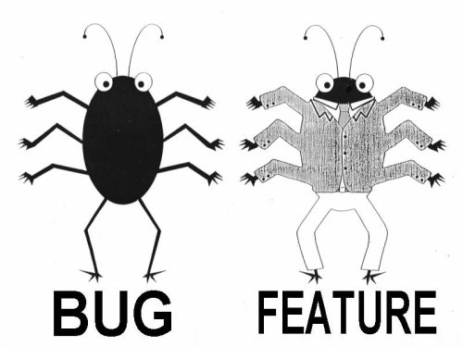
Lan Cao - Estimating Agile Software Project Effort: An Empirical Study
2X
Uncertainty,
Notes:
Lessons learned: If uncertainty is high, work on it earlier. Reduce Technical Debt—Get to potentially shippable at each iteration. Finding and fixing the last bugs has high uncertainty – plan on there being uncertainty.

Slide 67
#8: We’re a bit behind, but we’ll make it up in testing since most of our uncertainty was in the features.

Slide 68

Sources of Error
Scope Creep

Slide 69
We want this
Innovation
Revenue
Predictability
Efficiency
CLOUD
Social Networking
Late projects
Mobility
Integration
SOA
Business
Intelligence
BPM
Agile
Notes:
Chris taped one of the investment bankers at his previous job

Slide 70

Scope Creep
Capers Jones
  2% per month
  27% per year

Slide 71
#9: Scope Creep is a major source of estimation error.

Slide 72
Group Estimation Exercise
Number of Jellybeans in the jar

Slide 73



Wisdom of Crowds
“Who Wants To Be a Millionaire?” audience correct 91%
Dutch Tulips

Slide 74

Collaborating with Non-Collaborators
Collaborator
Creative
Tension
Collegial
More useful
Drive to
Purpose
Collaboration
Non-
Collaborator
Compliance
Combative
Common Practice
Agree
Disagree
Agreement

Slide 75
#10: Having more estimators, even if they are not experts, improves estimation accuracy

Slide 76
Capers Jones,
Estimating Software Costs 1998

Slide 77
Other Studies
Jørgensen 2007
  10 out of 16 studies reviewed report that judgment-based effort estimation methods led to more accurate effort estimates than formal models.
  Informal analogy with expert judgment based on intuition and experience is used 80-100%.
Basic COCOMO reports within 30% accuracy 29% of the time.

Slide 78
Other Studies
"Variants in FP counting methodologies can result in variances of up to +/- 50%."
Capers Jones Selecting a FP Counting Method
At any one system size, the effort required to build it varies widely. For example collected project data at the size of 100,000 SLOC, effort ranges from a low of 10 person months to a high of 2,500 person months.
Putnam and Myers, 2000; Stutzke, 2000

Slide 79


#11: Estimation tools are more accurate than expert or judgment estimation
Inconclusive

Slide 80

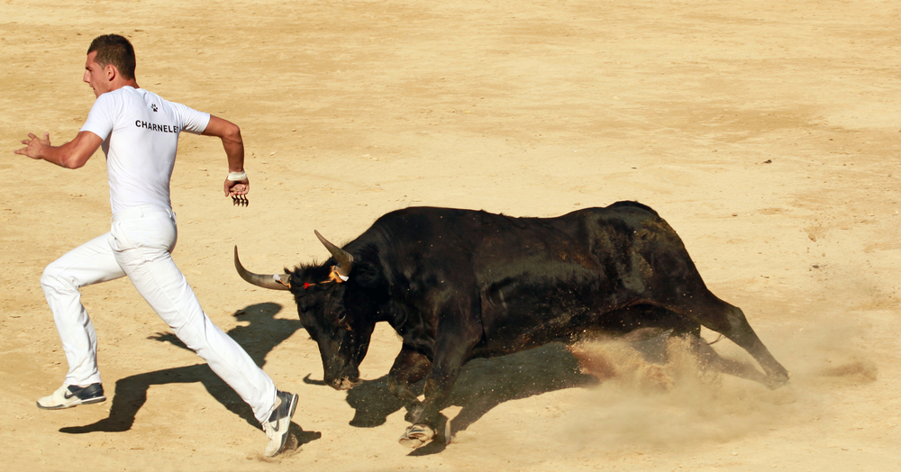
Risk and Uncertainty
 | Risk | Uncertainty
Frank Knight | Immeasurable | Quantifiable
PMI | Risk can be positive or negative | ???
English | A situation involving exposure to danger | The state of being uncertain Not known or established; questionable

Slide 81

Risky Business

Slide 82
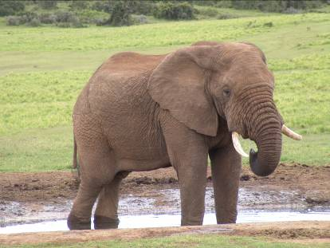
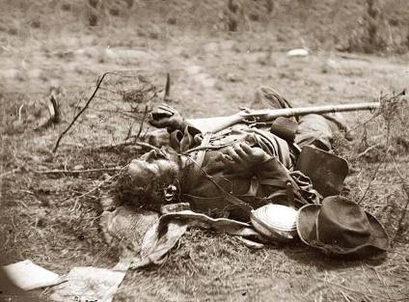
War
They couldn't hit an elephant at this dist…
General John B. Sedgwick, Union Army Civil War officer's last words, uttered during the Battle of Spotsylvania, 1864
Notes:
War – now that’s an area with lots of risk. I guess he didn’t do too well in his prediction.

Slide 83

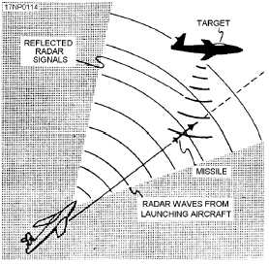
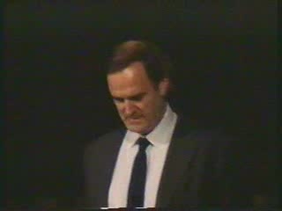
Gordon the Guided Missile

Slide 84
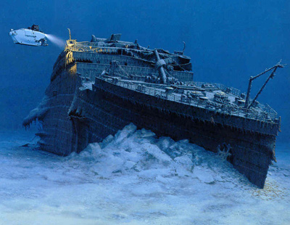

Movies
78% of Films Lose Money
6% of films make 80% of profit
Notes:
Most movies strive to be the next Titanic, the largest grossing film of all time.
The reality is that the vast majority really do end up closer to the real Titanic than to the movie Titanic.

Slide 85
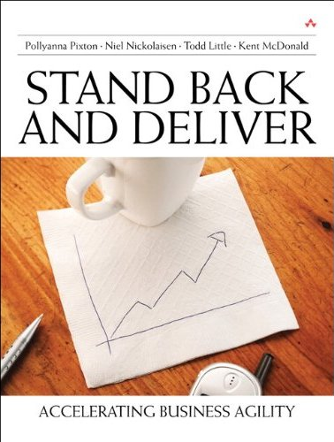
Books
300,000 in 2004,
<25% sold more
Than 100 copies
Notes:
Books. Here is my book. Doesn’t it look like it is chock full of useful stuff?
But only 25% of books sell more than 100 copies. Please do your part so that I am not part of that statistic.

Slide 86

Poker

Slide 87

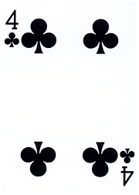
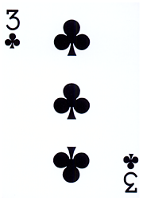

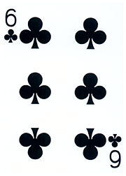

Texas Hold’em:
Which is the best hole hand?
A
B
C

Slide 88
Texas Hold’em:
Which is the best hole hand?
A
B
C
33.5%
29.6%
36.5%

Slide 89

Poker Metric:
Percent of Hands Won

Slide 90
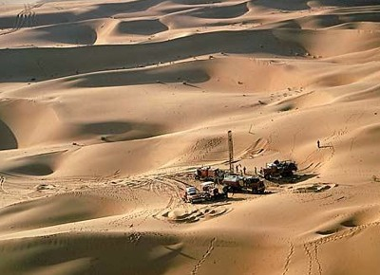
Oil & Gas Exploration
Notes:
Oil exploration is highly risky. It used to be that 10% was a good find rate for wildcat wells. Based on improvements in technology this is closer to 20%. Still risky, but that risk is acceptable because the payout is enormous. The key is having a diversified portfolio to balance the risk exposure.

Slide 91
Oil & Gas Exploration
90-80% Failure
Notes:
Oil exploration is highly risky. It used to be that 10% was a good find rate for wildcat wells. Based on improvements in technology this is closer to 20%. Still risky, but that risk is acceptable because the payout is enormous. The key is having a diversified portfolio to balance the risk exposure.

Slide 92
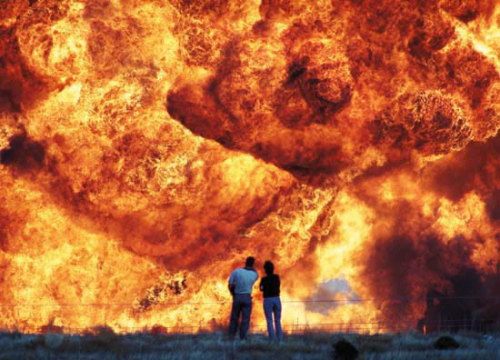
I’m beginning to think it wasn’t such a good idea to turn off those unit tests
Notes:
Safety is not to be messed with.
Test, Test, Test
Test again with real data
Test, Test, Test
Test again with real data

Slide 93
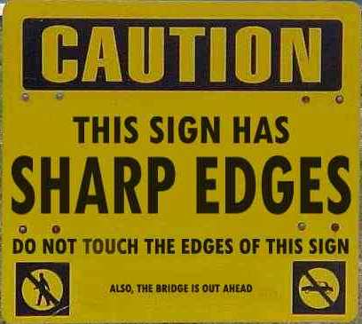
Notes:
Which risks are important? The sharp edges of the sign or the fact that the bridge is out ahead?

Slide 94
Which Uncertainties Are Important?
Notes:
Oil and gas geologists and engineers build models to help them comprehend the uncertainties. This is a tornado chart, because it looks like a tornado. This chart clearly shows that the largest uncertainty is associated with Reserves, with the next largest uncertainty being oil/gas price. This gives the engineer something to focus on. Perhaps there is additional data that can be collected to help reduce the uncertainty bars. There may not be anything that can be done about Oil/gas price. Perhaps futures contracts could be used to hedge some of the uncertainty. The other uncertainties may not be worth spending too much time since they have limited effect on the total uncertainty.

Slide 95

Wrong Priorities
Notes:
The first generation of Ford Taurus turned out to be the best selling car in America in the
late 1980s. Conceived in the 1980's and introduced in 1986, it set the standard for new practices
in project management and product development. It was one of the early projects in the U.S.,
which fully utilized the concept of cross-functional teams and concurrent engineering practices.
It established close ties with vendors and subcontractors, and was characterized by a spirit of
cooperation and strong synergy among teams. The result was a remarkable market and business
success. Its revolutionary design and outstanding quality, created a new trend in the U.S.
automobile industry, and customers simply loved the car. Yet, when the project was completed,
the project manager was fired. His “sin” was that project completion was delayed by six months.
In contrast, the second generation of Ford Taurus was developed in the early 1990s and
2
completed in 1995. With increased competition and the enormous success of Japanese imports,
Ford had hoped to reestablish Taurus, once again, as the best selling car in America. But the new
project manager learned the lesson of his predecessor: He considered project schedule as a “holy
grail,” and made sticking to the completion date the ultimate goal, while sacrificing other things.
Vendor relationships, team spirit, and product integration were just few of the issues that
suffered. The second generation of Taurus turned out to be a disappointing business experience.
It did not recapture the position of the best selling car in America and Ford was not able to repeat
its outstanding success of the first Taurus.

Slide 96
Compute This
"I recently asked a colleague [CIO] whether he would prefer to deliver a project somewhat late and over-budget but rich with business benefits or one that is on-time and underbudget but of scant value to the business. He thought it was a tough call, and then went for the on-time scenario. Delivering on-time and within budget is part of his IT department's performance metrics. Chasing after the elusive business value, over which he thought he had little control anyway, is not."
Cutter Sr. Consultant Helen Pukszta

Slide 97
Software Tornado Example
Item | -15M |  | 0M |  | 15M |  | 30M |  | 45M
Product Acceptance Uncertainty |  |  | ██ | ███ | ███ | ███ | ███ | ███ | ███
Schedule Uncertainty |  |  | █ | ███ | ███ | ██
General Market Uncertainty |  |  |  |  | ██ | ██
Cost Uncertainty |  |  |  |  | ██ | █

Slide 98
Software Tornado Example
Item | -15M |  | 0M |  | 15M |  | 30M |  | 45M
Product Acceptance Uncertainty |  |  |  | ███ | ███ | ███ | ███ | ███ | ███
Schedule Uncertainty |  |  |  | ███ | ███ | ██
General Market Uncertainty |  |  |  |  | ██ | ██
Cost Uncertainty |  |  |  |  | ██ | █

Slide 99
Software Tornado Example
Item | -15M |  | 0M |  | 15M |  | 30M |  | 45M
Product Acceptance Uncertainty |  |  |  | ███ | ███
Schedule Uncertainty |  |  |  | ███ | ██
General Market Uncertainty |  |  |  | ██ | ██
Cost Uncertainty |  |  |  | ██ | █

Slide 100
The Measurement Inversion
In a business case, the economic value of measuring a variable is usually inversely proportional to the measurement attention it typically gets.
Lowest
Information Value
Most Measured
Initial cost
Long-term costs
Cost saving benefit other than labor productivity
Labor productivity
Revenue enhancement
Technology adoption rate
Project value
Highest Information Value
Least Measured

Slide 101
#12: Project success is determined by on-time delivery

Slide 102
#13: Estimation is waste

Slide 103
Break

Slide 104
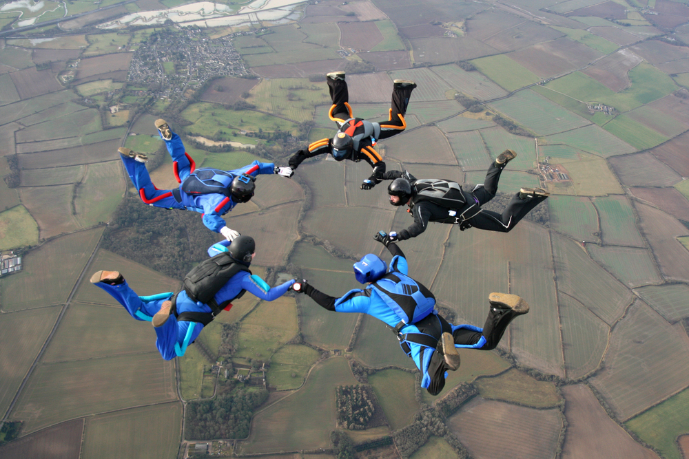
Risk management tools

Slide 105

Real Options
The right — but not the obligation — to undertake certain actions prior to an expiry date

Slide 106

Airline Tickets

Slide 107


Slide 108



Real Options
The right, but not the obligation to take some action prior to an expiry date

Slide 109
Do you have a choice?
Option
Commitment
Decision

Slide 110

Notes:
http://www.flickr.com/photos/nick_anderson/5049751331/sizes/m/in/photostream/

Slide 111
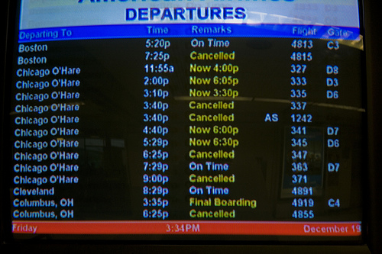
Real Options
Value of Information
Value of Flexibility

Slide 112

Value of Information

Slide 113
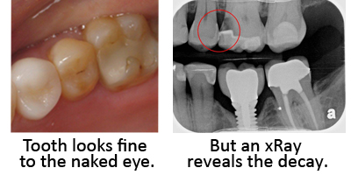
Value of Information

Slide 114
Increasing Value & Cost of Info.
Aim for this range
$$$
EVPI
EVPI – Expected Value of Perfect Information
ECI – Expected Cost of Information
EVI – Expected Value of Information
Value or Cost
EVI
ECI
$0
Perfect Information
Low certainty
High certainty

Slide 115


Value of Flexibility
The right — but not the obligation — to undertake certain actions prior to an expiry date

Slide 116
Making An Agile Conference Agile
5 Extra weeks to review sessions

Slide 118
From Variation to Chaos
(De Meyer, Loch, and Pich, MIT Sloan 2002)
Type of Uncertainty
No Uncertainty | Simple cause and effect
Variation | Activities have normal variation not specifically related to an identifiable cause
Foreseen Uncertainty | A known potential uncertainty
Unforeseen Uncertainty | An unknown potential uncertainty
Chaos | Fundamental uncertainty about the basic structure of the project itself

Slide 119
From Variation to Chaos
(De Meyer, Loch, and Pich, MIT Sloan 2002)
Type of Uncertainty | PM Style | Actions
No Uncertainty | Coordinator | Optimize schedule and manage critical path
Variation | Trouble Shooter and Expediter | Manage buffers
Foreseen Uncertainty | Risk Planner | Anticipate uncertainty and execute on mitigation triggers
Unforeseen Uncertainty | Flexible Orchestrator and Proactive Risk Manager | Proactively re-evaluate risk and re-plan as necessary
Chaos | Entrepreneurial and Knowledge Manager | Iteratively re-plan

Slide 120
From Variation to Chaos
(De Meyer, Loch, and Pich, MIT Sloan 2002)
 | Cruise ship with known components | Earth-moving, Infra-structure development with unknown ground conditions | Hi-tech startup with unknown market
Chaos | g | gg | gggggggg
Unforeseen Risk | gg | ggg | ggggg
Foreseen Risk | ggg | gggggg | ggg
Variation | ggggg | ggggg | gg
Action | Focus on schedule optimization and management of variation via buffers | Manage contingency plans for Foreseen risk, while continually updating plans based on Unforeseen risks. | Iteratively re-plan on a regular basis.

Slide 121
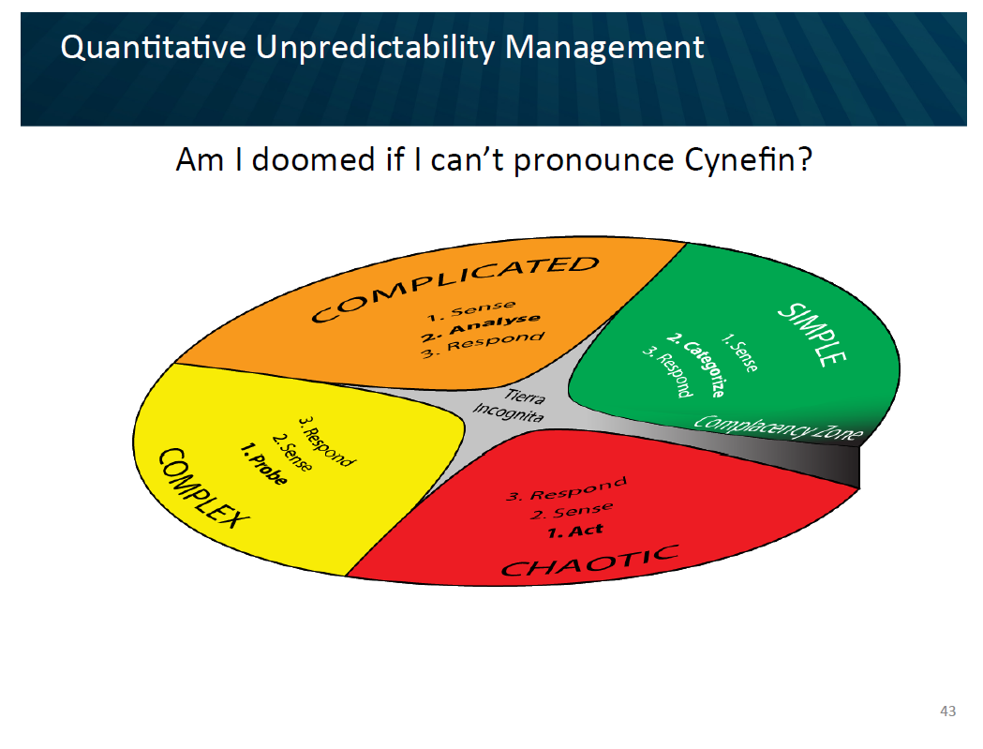

Slide 122
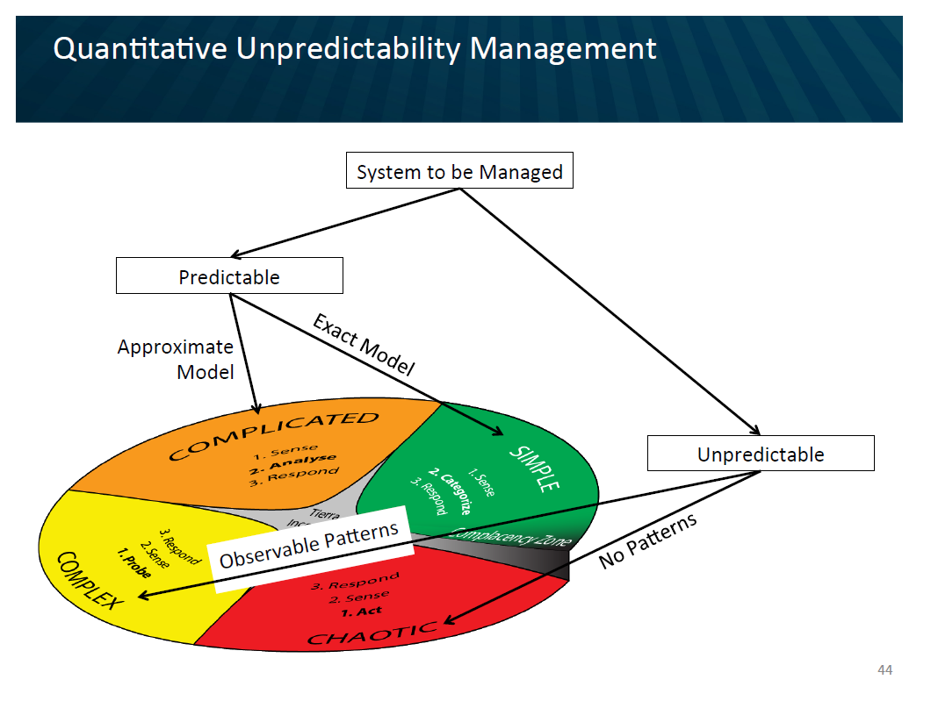

Slide 123
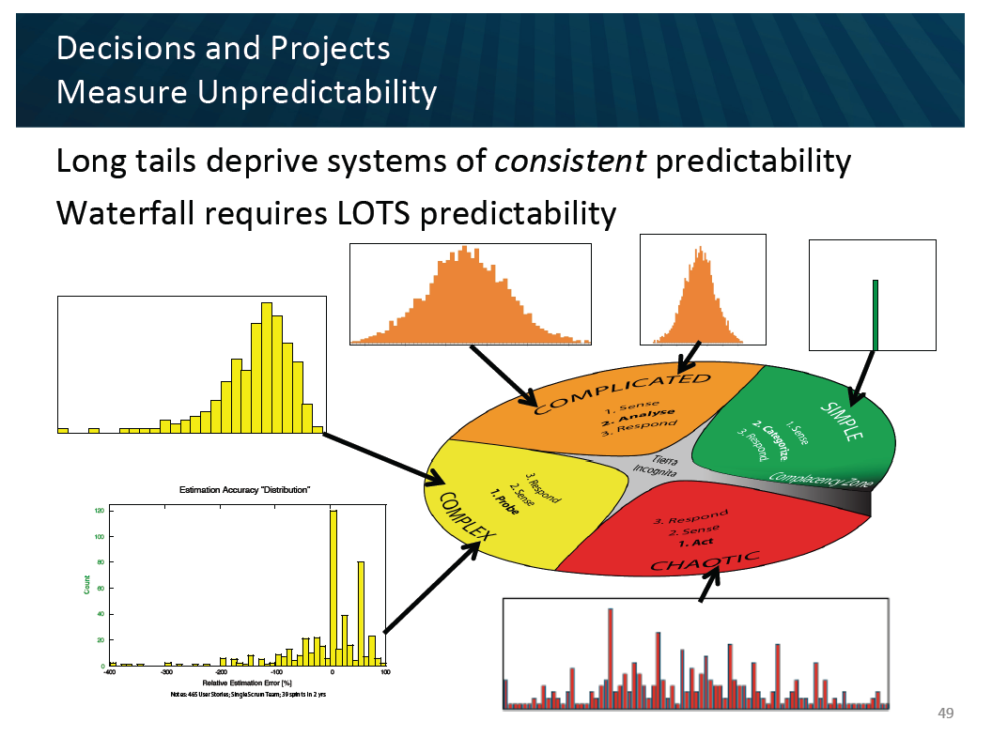

Slide 124

Context Leadership Model
Colts
Bulls
Uncertainty
Cows
Sheep Dogs
Project Complexity

Slide 125
Context Leadership Model
High
Colts
Bulls
Simple, young projects.
Agility to handle uncertainty
Need agility
Process definition to cope
with complexity
Tight Teams
Uncertainty
Cows
Sheep Dogs
Complex, mature market
laissez faire
Need defined interfaces
Low
Low
High
Project Complexity

Slide 126
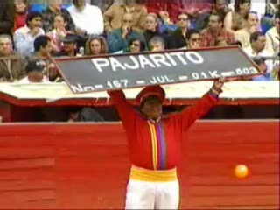
Bull Product Release

Slide 127
Reduce Uncertainty or Complexity
Uncertainty | Complexity
Opportunities to Reduce Uncertainty: Use proven technologies Reduce project duration | Opportunities to Reduce Complexity: Collocate the team Break project into sub-projects
Attribute | Score
Market | ███
Technical | ███
# Customers | █████████
Duration | █████████
Change | ███
Attribute | Score
Team Size | █████████
Mission Critical | █████████
Team Location | █████████
Team Maturity | ███
Domain Gaps | ███
Dependencies | █████████

Slide 128
Partitioning
Colt Project
Bull Program
Dog Project
Cow Project
Remember: Loose Coupling and Strong Cohesion

Slide 129

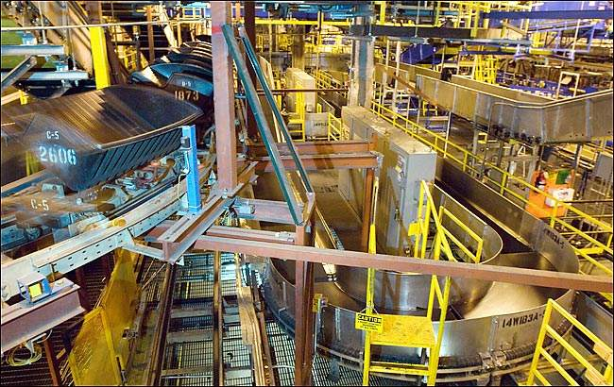
Delivery Failure results in Collateral Damage
Notes:
When the Denver Airport baggage handling system was designed, for example, no one asked what would happen if the fully automated system failed. How would baggage be handed? No one thought about it and there we no accommodations made in the airport plan. So when the system did fail there were no other alternatives to move baggage around the airport. There were no underground roadways on which to manually move luggage using tugs.

Slide 130

Risk Management and Real Options
Automated Baggage
Airport
Traditional Baggage

Slide 131
Leadership Development
People
Business
Process
Technology

Slide 132
Leadership Development
High
Colts
Bulls
Business
& Technology
Uncertainty
People
& Process
Cows
SheepDogs
Low
Low
High
Project Complexity

Slide 133
Portfolio Management
Uncertainty
Project Complexity

Slide 134
Project Leadership Guide
Create
Change
Embrace
Change
High
Invent
Deploy
Market
Differentiating
Ad Hoc
Agile
Eliminate
Change
Control Change
Manage
Offload
Low
Outsource
Structured
Low
Mission Critical
High

Slide 135

Not all dogs are the same
Notes:
Don’t over stereotype. Dogs are similar, but not all the same. In this case, both dogs get the job done.
Talk about Risk management…….

Slide 136
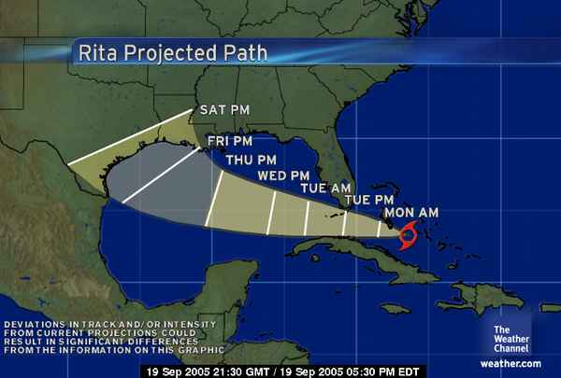
The Cone of Uncertainty
We expect uncertainty and manage for it through iterations, anticipation, and adaptation.
Notes:
Inspection and adaptation is the answer. Iterations help bring in new information

Slide 137
Uncertainty Bounds
10% exceed 3-4x
Median project 1.7x
10-20% on time

Slide 138
The A/B/C List sets proper expectations
A | MUST be completed in order to ship the product and the schedule will be slipped if necessary to make this commitment.
B | Is TARGETED to be completed in order to ship the product, but may be dropped without consequence.
C | Is NOT TARGETED to be completed prior to shipping, but might make it if time allows.
Only “A” features may be committed to customers.
If more than 50% of the planned effort is allocated to “A” items the project is at risk.

Slide 139
A/B/C List
50%
25%
25%
A
B
C
D
Typical Delivery
C
A
B
Backlog Plan
Target Delivery Date
50%
100%

Slide 140
A/B/C List
A
50%
25%
25%
B
C
D
Uncertainty Risk
C
A
B
Backlog Plan
Target Delivery Date
50%
100%
Notes:
Need some explanation to go along with this slide and the previous one.
--The idea is that there is uncertainty in the estimation process. A factor of 2X is a generally sufficient buffer if the team has gotten basic estimation down. Thus is it possible that what is actually delivered is only the “A” items. That is ok and actually expected.

Slide 141
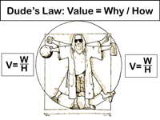

Slide 142
Estimating Story Difficulty
Estimation
XL
L
M
S
 | S | M | L | XL
Value
Cost

Slide 143


Product Innovation Flow
Flexible Scope
Backlog
Hot Items
Idea Filter
Iteration
Backlog
Product
Backlog
Newly Discovered
Items
Project Sanction
RTM
Sales
Services
Customer
Support
B & C
Release
Backlog
Adaptive Activities
A
Items
CORE Activities
Most Items for consideration in next release
B/C/D
Backlog Burnup
A

Slide 144

No Surprises!
Risk Management = Expectation Management

Slide 145
Iteration Review Questions
What promises have been made, to whom were they made, and who made them?
What key decisions or commitments might we have to make within the next 2 iterations?
Questions to ask team anonymously
  When will we be ready to ship?
  Will we be able to keep our promises?
  Is the team healthy and operating effectively?
  Is the team on the right path?

Slide 146
Ask the Team

Slide 147
Analyze Uncertainty
opportunity
Early Finish
We’ll rock at Scrum
impact
negligible
Evaluation Sickness
Task Switching
Scope creep
showstopper
Alien Invasion
improbable
probability
near certainty
Notes:
To understand the fit of the project team with the organization, determine boundaries and interactions, determine resource commitment by checking actual availability of core team members and do a prospective analysis, i.e. a Project Risk Analysis.

Slide 149
Risk
Technical Uncertainty
Technical Uncertainty
Uncertain
Benefits
Manual Process
Complexity
Uncertain
Benefits
Manual Process
Complexity
Lack of
Standardization
Rules Engine
Complexity
Lack of
Standardization
Rules Engine
Complexity

Slide 150
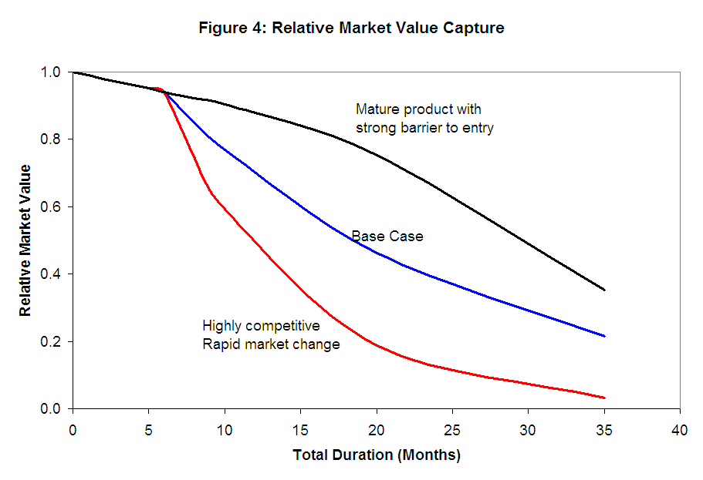
Cost of Delay

Slide 151
Uncertainty
Know that
we know
Know that
we don’t know
Don’t know that
we know
Knowable
Unknowable
Don’t know that
we don’t know
Notes:
This slide works best in animation mode. There are some things that we know that we know. This is essentially the spec. If everything goes well, this is the best we could do. There are some things that we know that we don’t know. These are typical project risks. There is another category of things that we don’t know that we don’t know. Some of these might be knowable if we put more effort into planning, but some of these are fundamentally unknowable in advance. (I ignore the Don’t know that we know. Some people refer to this quadrant as intuition or reflexes.). The unknowable section is what Fred Brooks refers to as the Werewolf.

Slide 152
Uncertainty
Know that
we know
Wishful Thinking
p10
Know that
we don’t know
Discoverable Risks
p50
Don’t know that
we know
Knowable
Unknowable
Don’t know that
we don’t know
Uncertainty
Management
p90
Notes:
This slide works best in animation mode. We plan around that which we know. Traditional risk management focuses on risk identification and mitigation strategies, but can only manage risks that are known. Good risk management will result in good p50 estimates, or perhaps better. It is the unknowable that creates chaos. Shit happens. Market direction changes, reorganizations, new project priorities, customer commitments, attrition or RIF, etc. This is the importance of agility and flexibility in setting up project success criteria.

Slide 153


Simulation Exercise
ID: 1 Value: Sum of all dice
Major feature
Test: Roll 3 dice - 2 or more dice are the same
Commit Points: 2

Slide 154
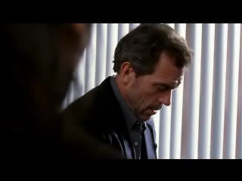
Risk Management is not Risk Aversion

Slide 155
Contact
Todd Little
  todd@toddlittleweb.com
  www.toddlittleweb.com
  www.accelinnova.com

